Slide 1

Growatt Monitoring System

Slide 2
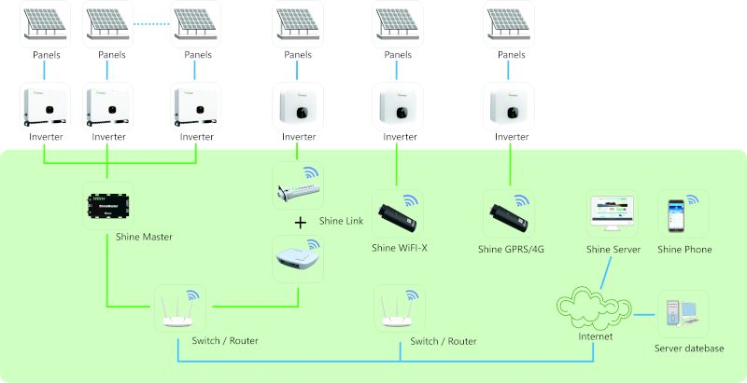
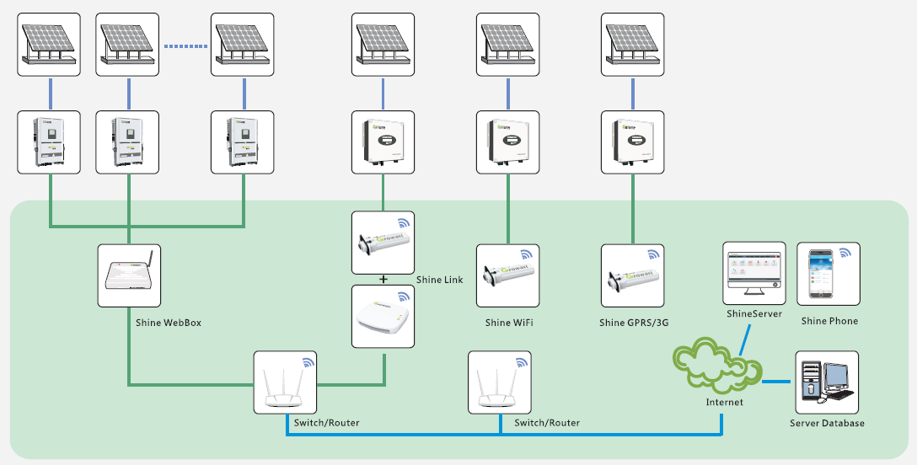
Growatt monitoring system overview

Slide 3
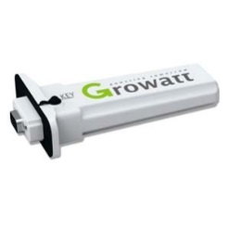
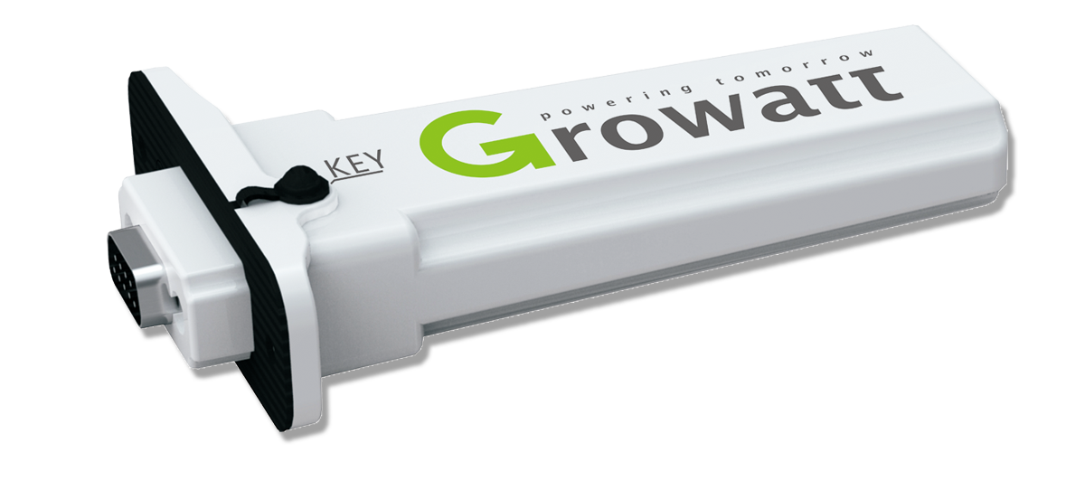
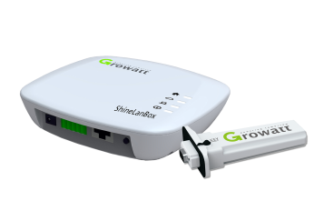
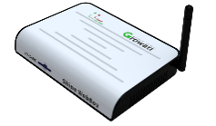
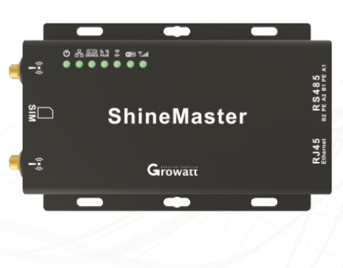
Flexible options for different application scenarios
Wireless，one inverter
Solution for residential and small commercial system
Easy configuration via ShinePhone APP
Max. communication range 100m
Shine WIFI
Wireless，one inverter
Solution for residential and small commercial system
Easy configuration via ShinePhone APP
2G,4G network monitoring
Shine GPRS
Wireless，Max. 8 inverters
Solution for small residential and small commercial system
Easy installation, plug-and-play
Max. communication range 200m,
Shine Link
RS485, max. 32 inverters
Low cost solution for middle-large system
Max. RS485 length 1000m
Shine Master

Slide 4
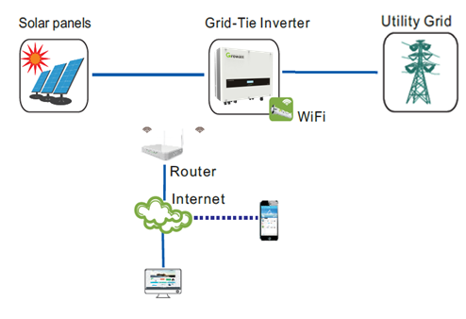
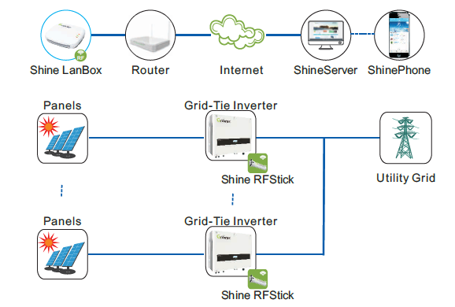



Residential system monitoring solution
Shine WIFI
Shine Link

Slide 5
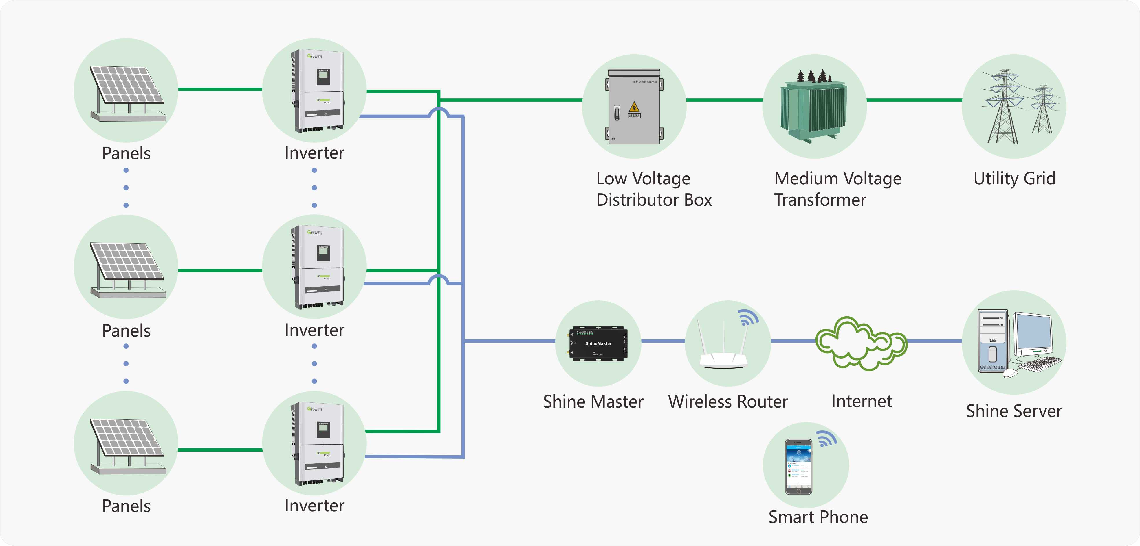

Commercial system monitoring solution
Shine Master

Slide 6
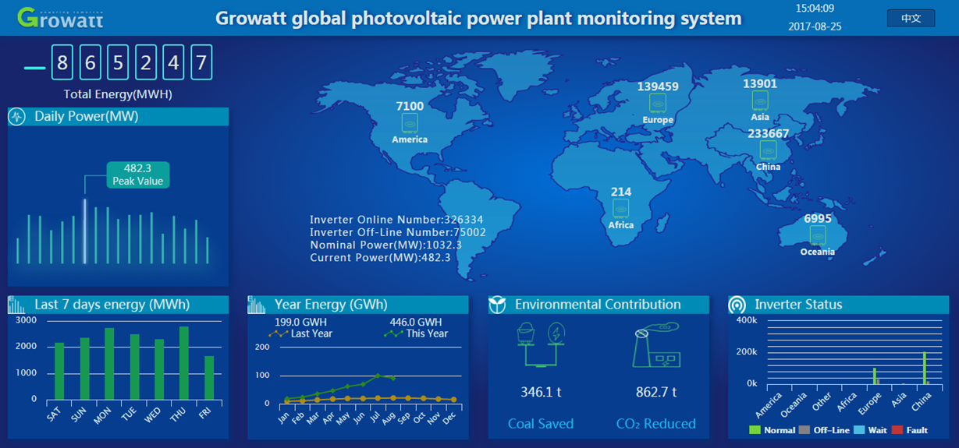
Total 300,000+ system online
Based on cloud database statistic analysis, 300,000+ online PV systems can be rapidly scanned within 20 minutes.

Slide 7
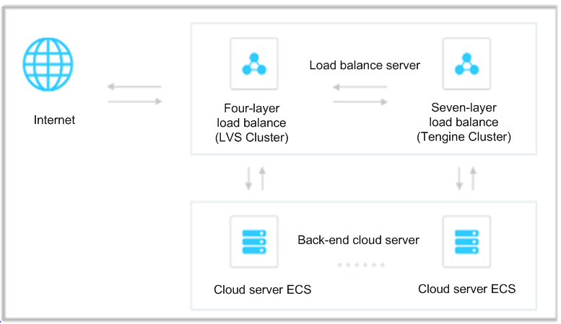
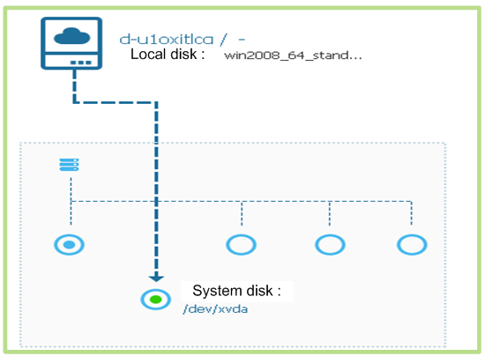
Reliable cloud server support data storage
Distributed cloud structure, never goes down
Backup database everyday, never lost

Slide 8
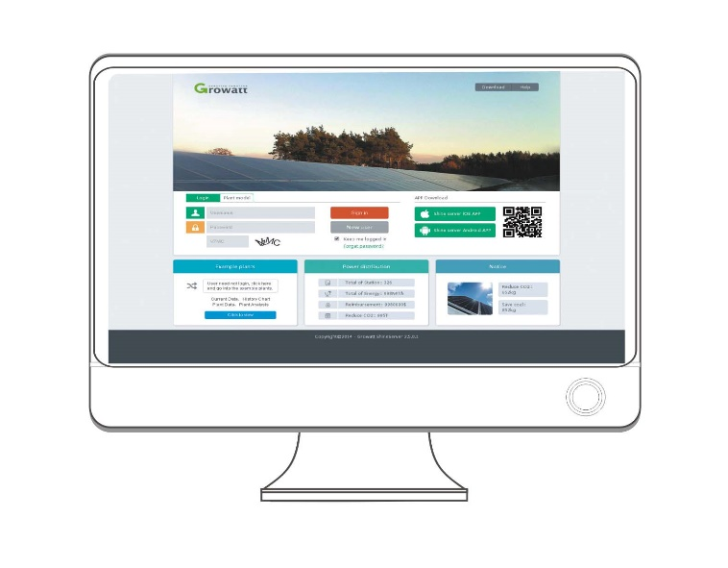
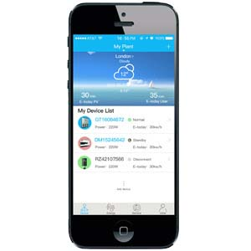
It’s more than easy to control your PV and storage system
Growatt Shine Server
Suitable for display on bigger screen, easy to check details of plant data and devices parameter.
Shine Phone APP
keep an eye on everything at all time.

Slide 9
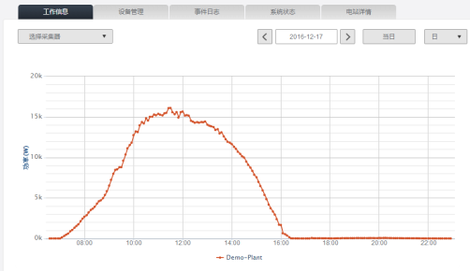
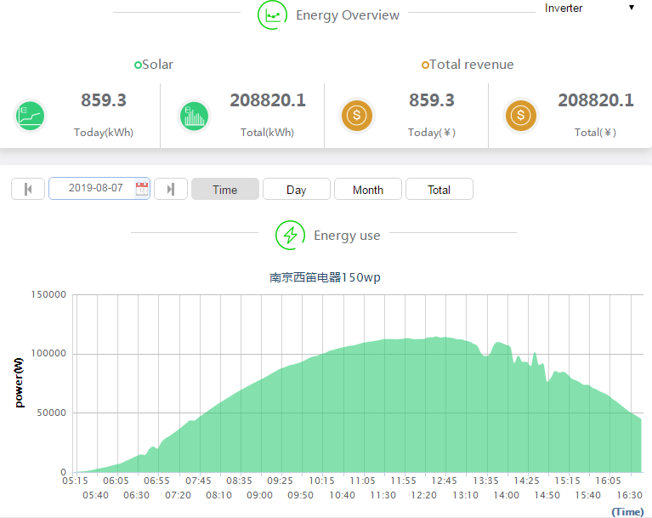
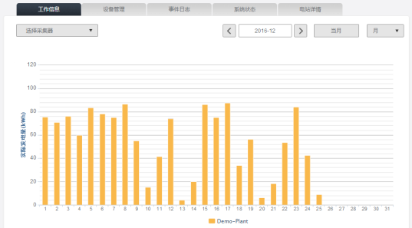
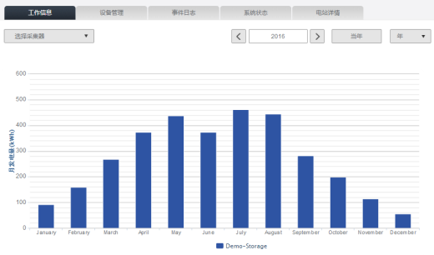
Showing real time data of your PV and storage system

Slide 10
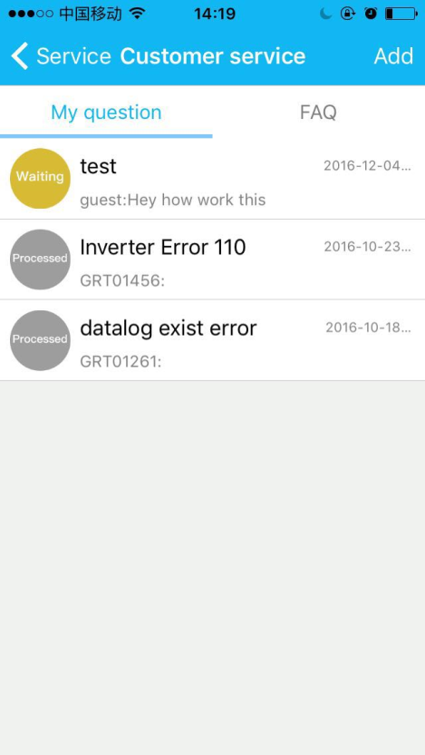
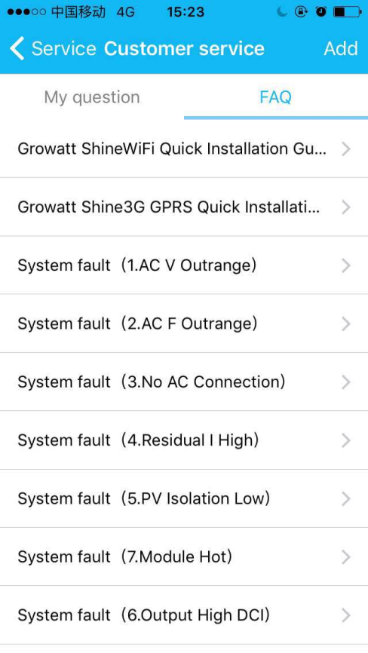
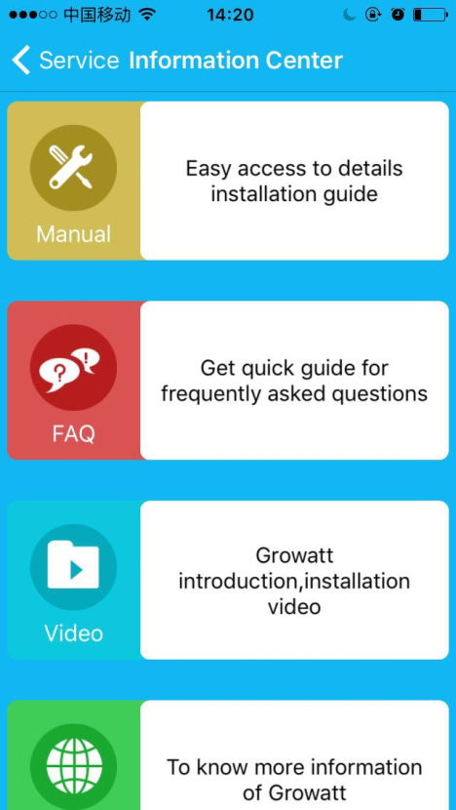
Much more than just monitoring
Online service
FAQ
Information Center

Slide 11

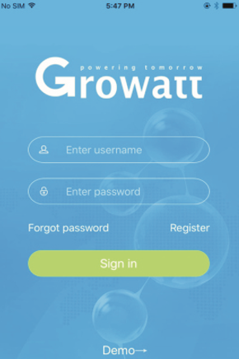

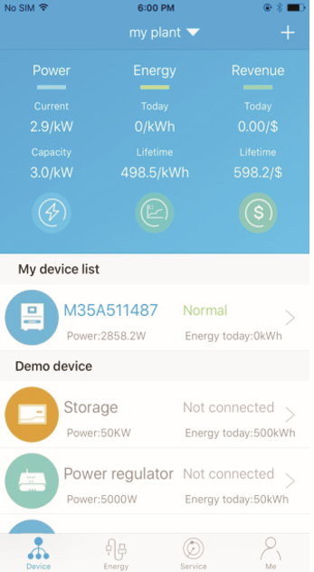
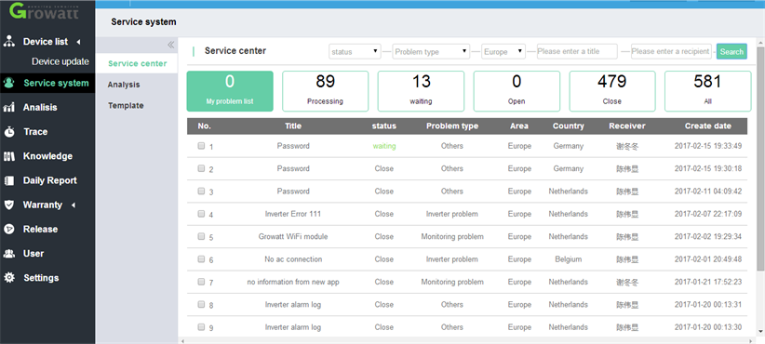
Mobile service system, real-time online question answering
Shine Phone APP platform
OSS system web server platform

Slide 12
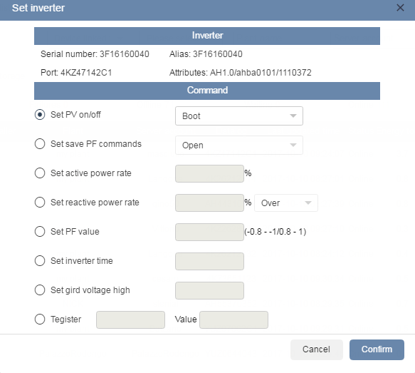
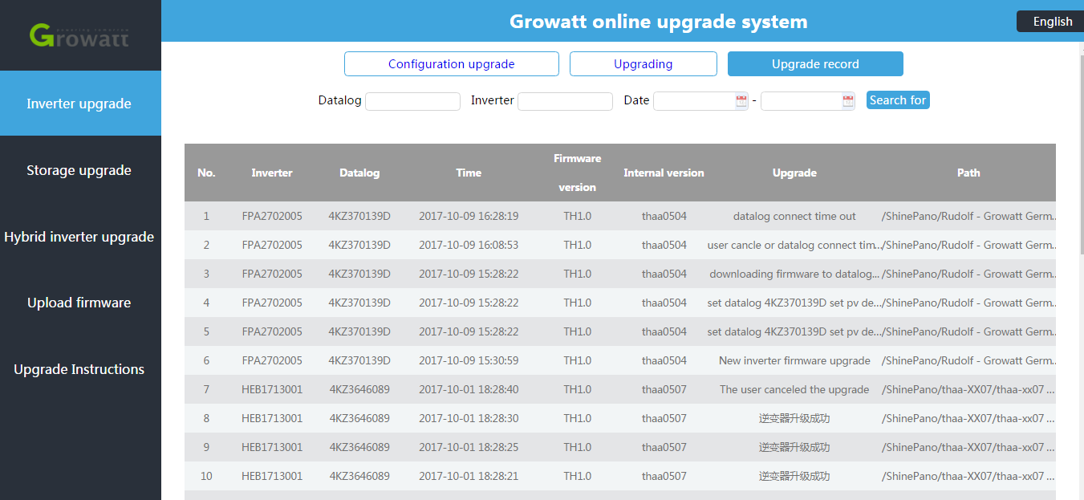
Remote Maintenance, reduce cost of on-site service
Remote Configuration Remote FW Update
Growatt service engineer almost can handle 60%+ problems by remote configuration and FW update without on-site service, saving time and cost for installers and distributors.

Slide 13
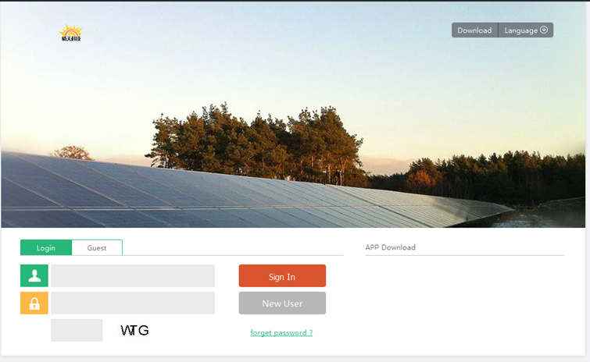
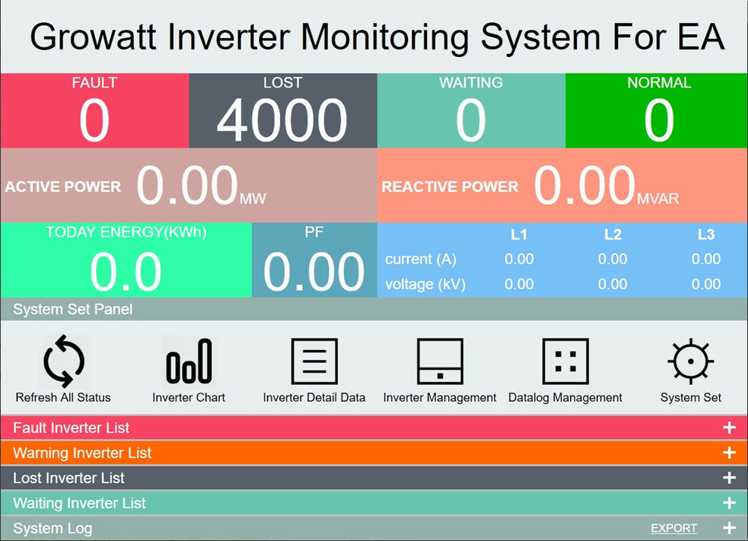
Flexible customized service
OEM Growatt Shine Server
Customized show platform

Slide 14
Flexible API options
An application programming interface (API) is a set of programming instructions and standards foraccessing a Web-based software application.
Using the Growatt API, website developer can easy access to Growatt ShineServer, and get information and display on third-party website in 2 ways:
a. Only get plant data from Growatt ShineServer account
(Customer need have normal account on Growatt ShineServer)
b. Customized third-party monitoring website based on Growatt ShineServer
(End users can register and visit account on third-party website)

Slide 15
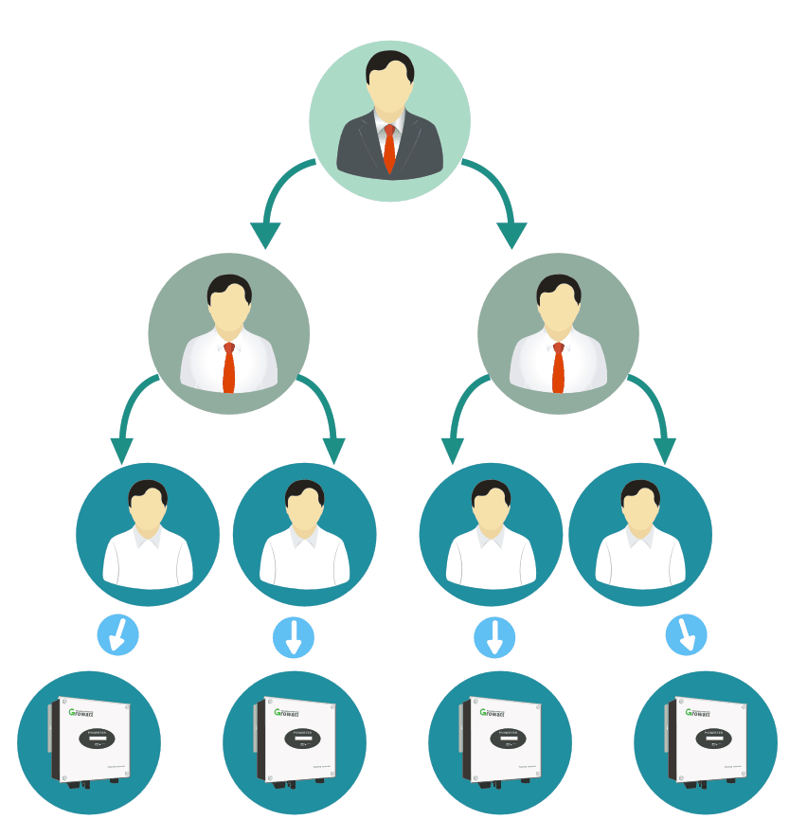
Customized account grading
Distributor can create installer code and manage his installers and all devices he sold, support remote configuration and FW update
Installer can manage his clients and all devices he sold
End user can create an account for his plants, as well as modify the plant information
Inverter data transfer to Growatt Shine Server every 5min via monitoring device
Distributor
Installer
End User
Device
Avoid on-site service, saving time and cost.

Slide 16
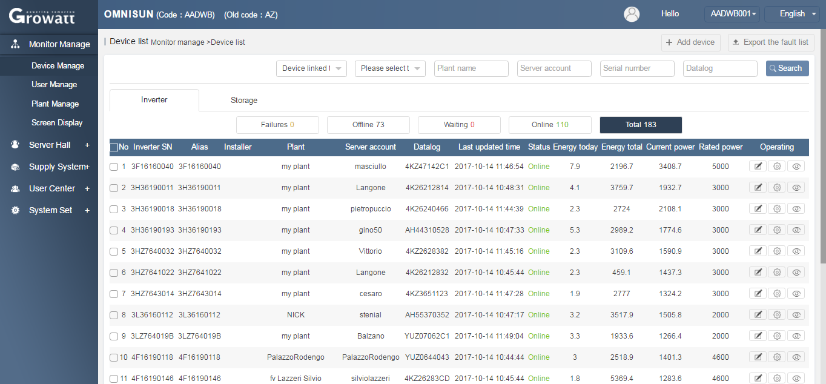
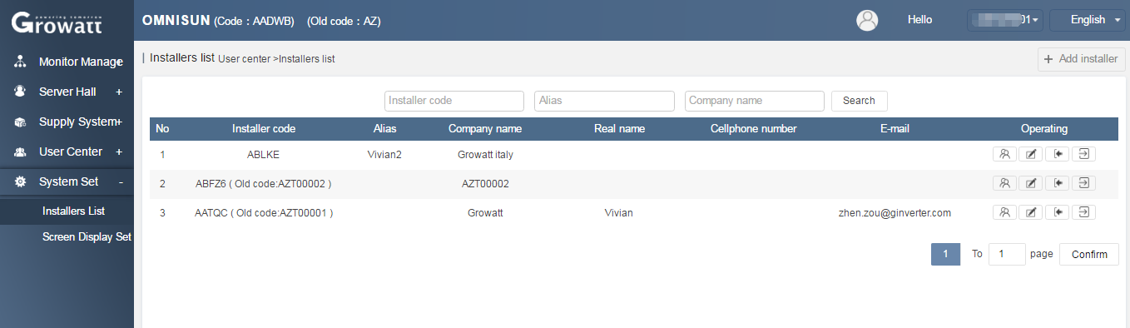
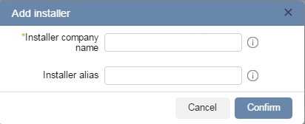
Distributor account overview

Slide 17

THANK YOU

